Slide 1
Numerical Solution of Non-linear Equations
Team Name : Team Gamma
Team leader : C193049 Jabed Iqbal Joy
Deputy leader : C193075 Mohammad Rahatul Islam
Member :
C193052 Fahim Chowdhury Jisun
C193057 Shuvo Das
C193053 Sakawat Hossain Chowdhury

Slide 2
Introduction
Numerical solution of non-linear equations is a crucial topic in various fields such as engineering, physics, and finance. Non-linear equations are ubiquitous in these fields and their solutions play a significant role in understanding complex phenomena. In this lab report, we aim to introduce the topic of numerical solution of non-linear equations and explain its importance in these fields.
We will use an informative and engaging tone to capture the audience's attention and provide them with a clear understanding of the significance of this topic.

Slide 3
Types of Numerical Solution of Non-linear Equations methods
Bisection Method
Newton-Raphson Method
Secant Method
False Position Method
Fixed-Point Method

Slide 4
Bisection Method
The bisection method (also known as binary chopping or half-interval method) is one of the simplest and most reliable of iterative methods for the solution of nonlinear equations. This method based on the repeated application of the intermediate value theorem
1.Decide initial values for x1 and x2 and stopping criterion E.
2. Compute f1 = f (x1) and f2 = f (x2).
3. If f1 * f2 > 0, x1 and x2 do not bracket any root and go to step 1.
4. Compute x0 = (x1 + x2) / 2 and compute f0 = f (x0).
5. If f1 * f0 < 0 then set x2 = x0 else set x1 = x0.
6. If absolute value of (x2-x1) is less then E, then root = (x1 + x2) / 2 and go to step 7 Else go to step 4
7. Stop

Slide 5
Newton-Raphson Method
The Newton-Raphson method, also known as Newton's method, is a numerical technique used to approximate the roots of a differentiable function. It is an iterative method that utilizes the derivative of the function to refine the approximation of the root.
Algorithm: Newton-Raphson Method
Assign an initial value for x, say x0 and stopping criterion E.
Compute f (x0) and f ‘(x0).
Find the improved estimate of x0x1 = x0 – f (x0) / f ’(x0)
Check for accuracy of the latest estimate.If | x1-x0 | < E then stop; otherwise continue.
Replace x0 by x1 and repeat steps 3 and 4

Slide 6
Secant Method
Secant method, like the False Position & Bisection methods , It starts with two initial guesses, and then iteratively constructs new points on the curve by extrapolating from the previous two points.
Algorithm: Secant Method
Decide two initial points x1 and x2 and required accuracy level E.
Compute f1 = f (x1) and f2 = f (x2)
Compute x3 = (f2 x1 – f1 x2) / (f2 – f1)
If |x3- x2| > E, then set x1 = x2 and f1 = f2set x2 = x3 and f2 = f(x3)go to step 3Elseset root = x3print results
Stop

Slide 7
False Position Method
The false position method, also known as the regula falsi method, is a numerical technique used to approximate the root of a continuous function within a specified interval. It is an iterative method that combines aspects of the bisection method with linear interpolation.
False Position Algorithm
Decide initial values for x1 and x2 and stopping criterion E.
Compute x0 = x1- (f(x1) (x2-x1) ) / (f (x2) – f (x1))
If f (x0) * f (x1) < 0 set x2 = x0 otherwise set x1 = x0
If the absolute difference of two successive x0 is less then E, then root = x0 and stop.Else go to step 2.

Slide 8
Fixed-Point Method
The fixed-point method, also known as the fixed-point iteration method, is a numerical technique used to find the fixed point of a given function. It is an iterative algorithm that repeatedly applies a transformation to an initial guess until convergence to the fixed point is achieved.
The fixed-point method involves the following steps:
Choose an initial guess for the fixed point, denoted as x₀.Apply the transformation function, denoted as g(x), to the initial guess: x₁ = g(x₀).Repeat the process by using the output of the previous step as the input for the next step: x₂ = g(x₁), x₃ = g(x₂), and so on.Continue iterating until convergence is achieved, typically by checking if the difference between successive iterations falls below a specified tolerance.

Slide 9
Project oUTPUT

Slide 10
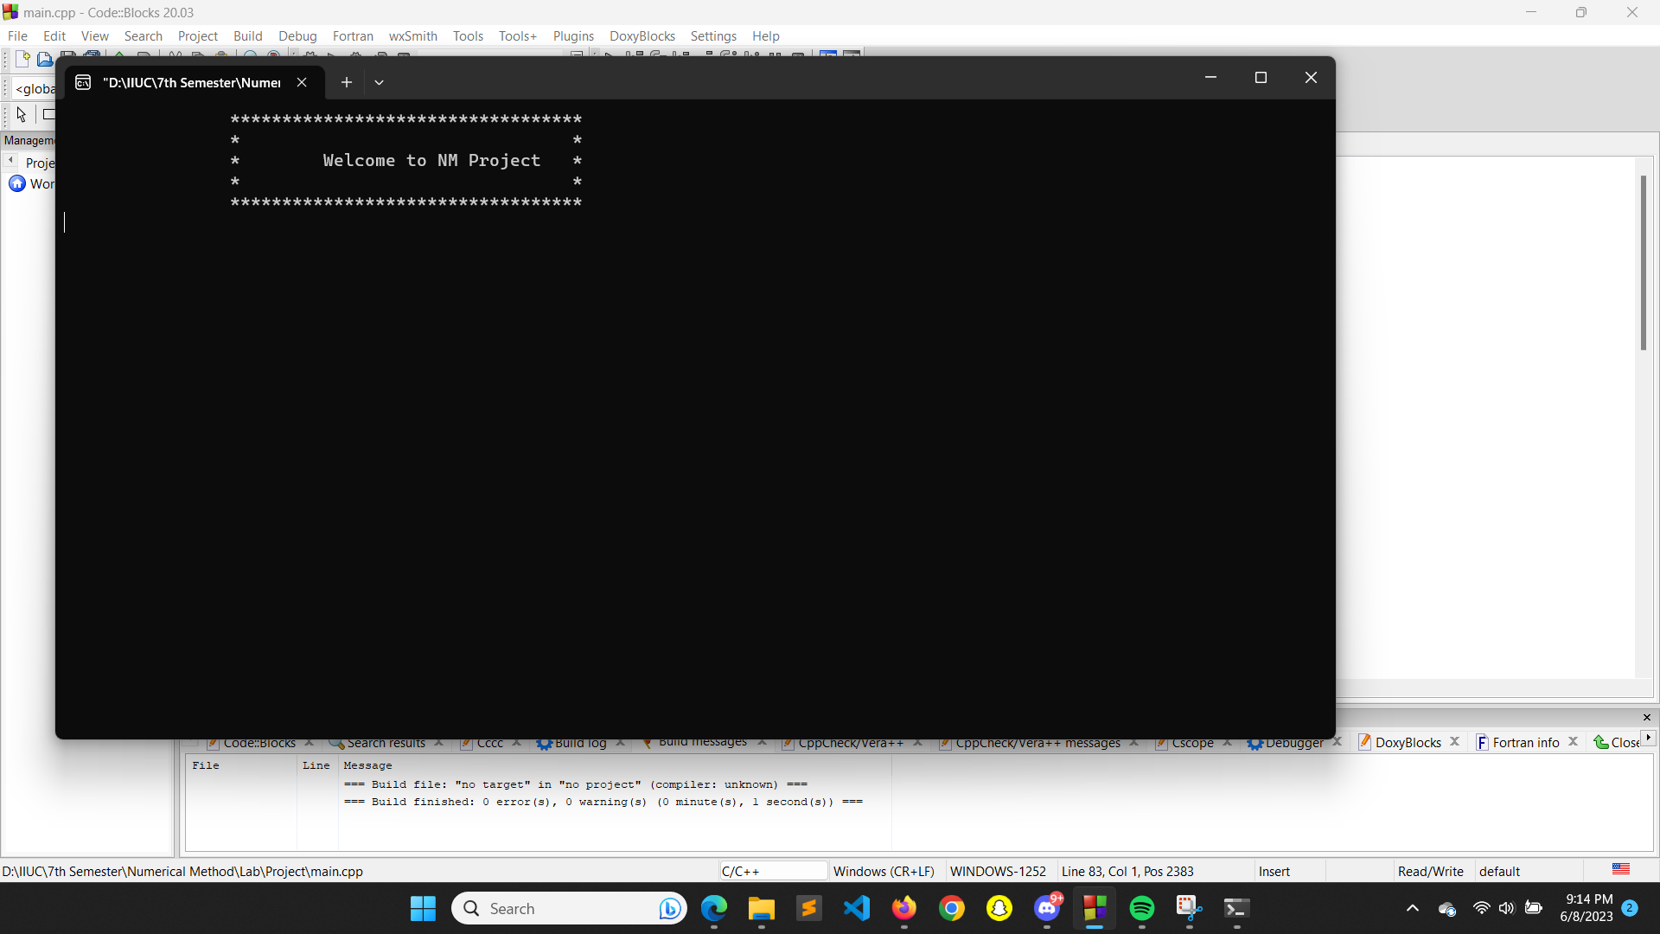

Slide 11


Slide 12
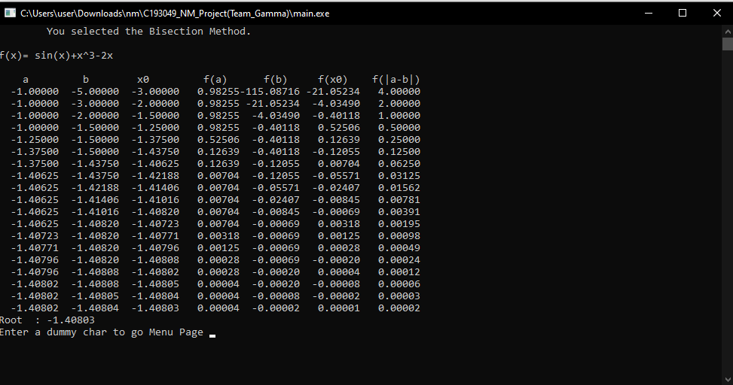

Slide 13
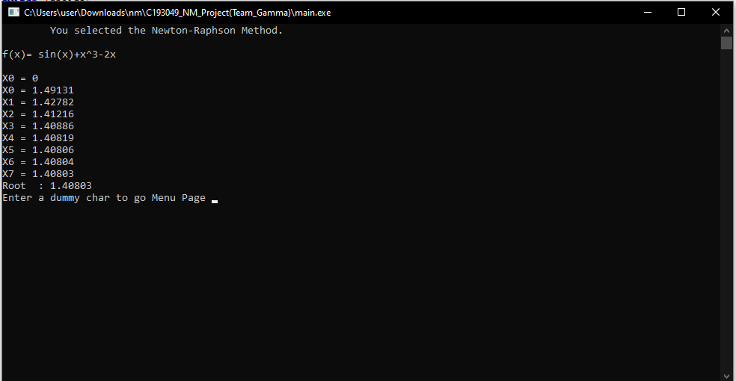

Slide 14
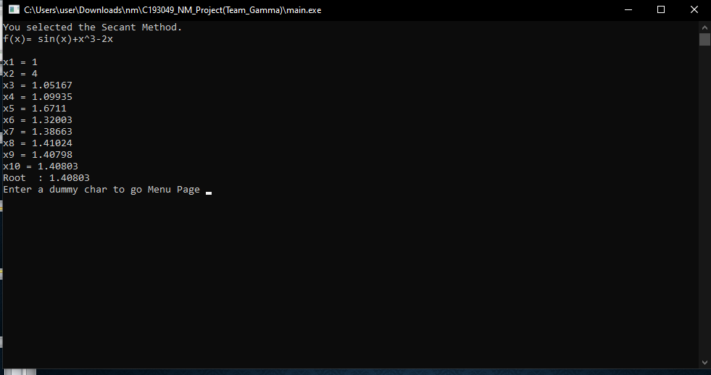

Slide 15
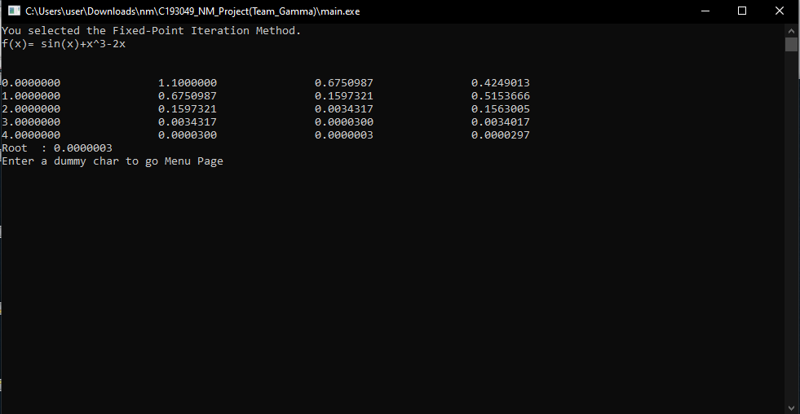

Slide 16
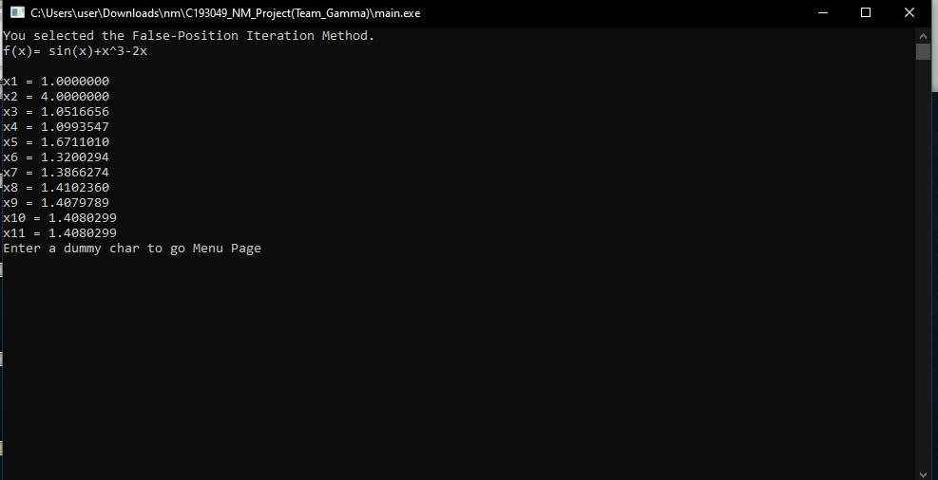

Slide 17
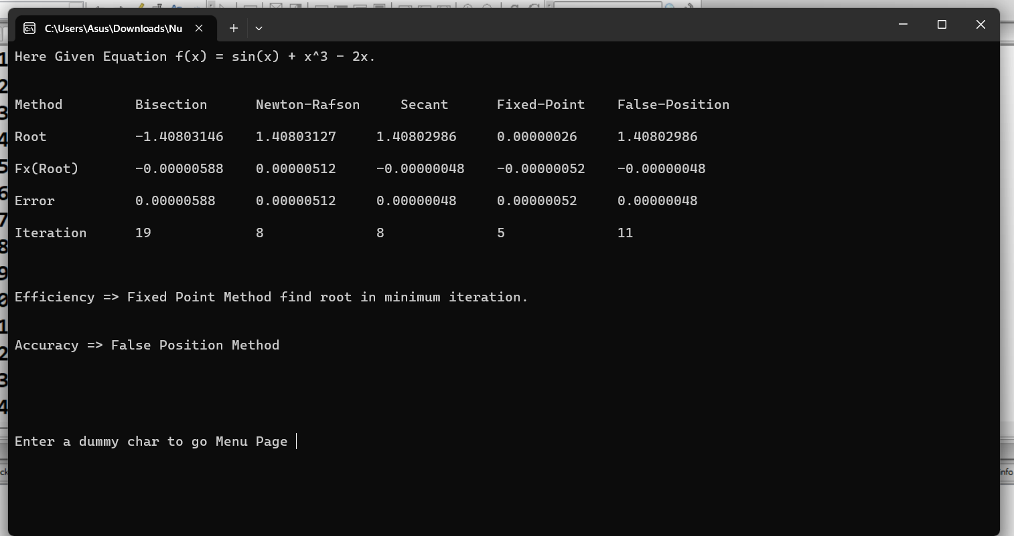
Result Analysis

Slide 18
Code Link
https://github.com/Jabed-Iqbal-Joy/Numerical_Method_Project_CSE-4746

Slide 19
Conclusion
In conclusion, this lab report has highlighted the importance of numerical solution of non-linear equations in various fields such as engineering, physics, and finance. We have solved specific non-linear equations using numerical methods such as the Newton-Raphson method and the shooting method and presented the results obtained. Our findings have significant implications for understanding complex phenomena in these fields.Our aim is to summarize the key findings of this lab report and emphasize the importance of numerical solution of non-linear equations in various fields in a persuasive tone to encourage the audience to appreciate the significance of our research.

